Slide 1



Introduction to
Feed-Forward Control

Slide 2

Learning Objective
Introduction to Feedforward Control
Introduction to Feedback Control
Drawbacks of Feedback Control
Difference b/w Feedforward and Feedback Control
Importance of Feedforward Control
Combined FF and FB Control
Feedforward with Longitudinal Control

Slide 3
Feedforward Control
Feedforward control is an effective way to rapidly eliminate the effect of the disturbance on the output.
Open loop control system
FF controller produce a reference output to achieve a particular tracking response when the required inputs are non-zero.
Reference
Feedforward Controller
Plant
Output

Slide 4
Feedback Control
Feedback control is a control in which the current output is compared to a reference signal.
Closed loop control system
FB controller provides a reactive response which eliminate control errors due to the disturbances that occurs.
Reference
Feedback Controller
Plant
Output

Slide 5
Drawback of FB Control
Feedback control is mostly used control but it has some drawback that can be covered by FF control system.
Perfect control cannot be occurred
Predictive control doesn’t occur
Control can be unsatisfactory for processes with large dead times or have slow process.

Slide 6
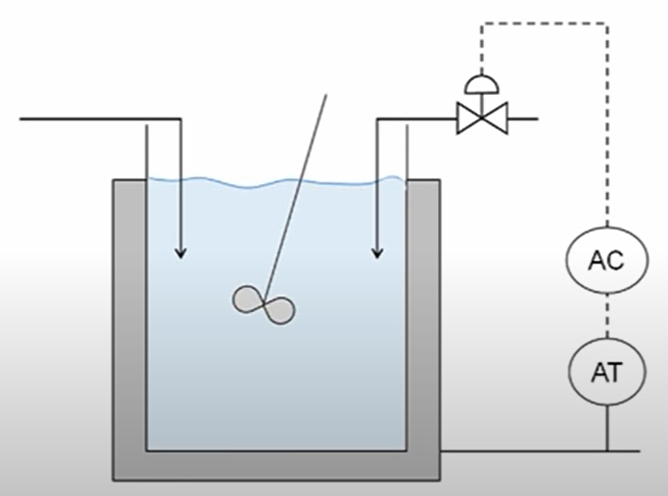
Solution to Drawbacks
Feedforward control is a way to handle these drawbacks.
Explained in this example.
Consider this blending tank.

Slide 7
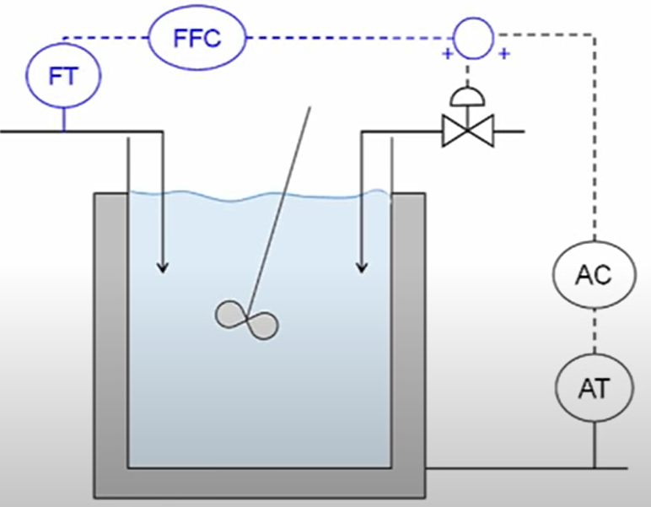
Solution to Drawbacks
Feedforward control is a way to handle these drawbacks.
Explained in this example.
Consider this blending tank.

Slide 8
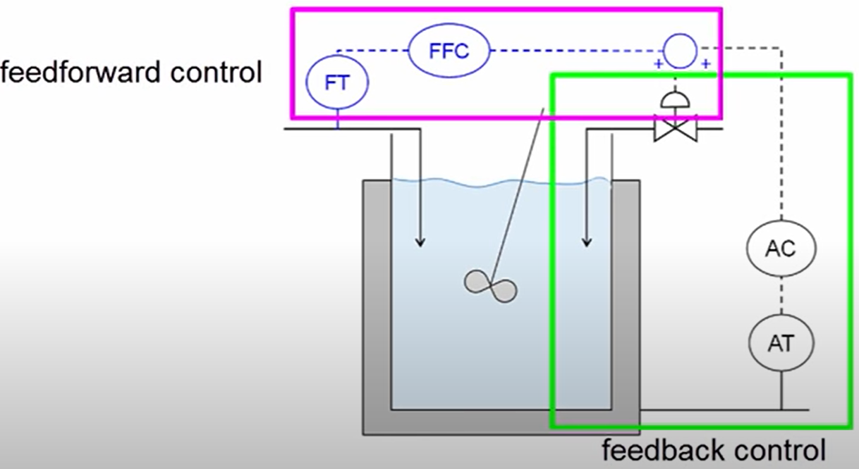
Solution to Drawbacks
Consider this blending tank.

Slide 9
Difference b/w FF & FB
Feedforward Control | Feedback Control
1. Requires identification and direct measurement of all disturbances in the system. | Doesn’t require measurement of all the disturbances in the system.
2. Sensitive to modeling errors. | Insensitive to modeling errors.
3. Sensitive to process parameter changes. | Insensitive to process parameter changes.
4. Control action starts before disturbance gets to the system. | The disturbance affects the system before control action starts.
5. Used with slow systems or systems with significant dead times. | Unsatisfactory with slow systems or systems with significant dead times.
6. Does not create any instability within the system. | Creates instability within the system.

Slide 10
Importance of FF Control
Most important reason is, it gives an advance alert by prediction for the upcoming error or disturbance.
Important to cover the drawbacks of Feedback control.
Important to use in combined control system for maximum accuracy.
It helps to produce actuation signal, the throttle and brake commands.

Slide 11
Combined FF & FB Control
In many applications FF and FB controllers are combined to improve the controller performance.
FF controller provides predictive response, non-zero offset
FB controller corrects the response, compensating disturbances and errors in the model
Feedforward Controller
Reference
Feedback Controller
Plant
Output

Slide 12
Combined FF & FB Control
FF controller provides a predictive response as they produce a reference output to achieve a particular tracking response.
FB controller provides a reactive response which eliminate control errors due to disturbance.
Predictive
Feedforward Controller
Reactive
Reference
Feedback Controller
Plant
Output

Slide 13
Vehicle Speed Control
Feedforward and Feedback Control applied to Longitudinal Vehicle Control.
Throttling & Braking
  The output of the Feedforward and feedback control blocks are the throttling or braking signals to accelerate or decelerate the vehicle (plant) to keep the vehicle velocity close to the reference velocity.
Predictive
Feedforward Controller
Reference
Velocity
Reactive
Vehicle
Velocity
Feedback Controller
Throttling
Plant
Braking

Slide 14
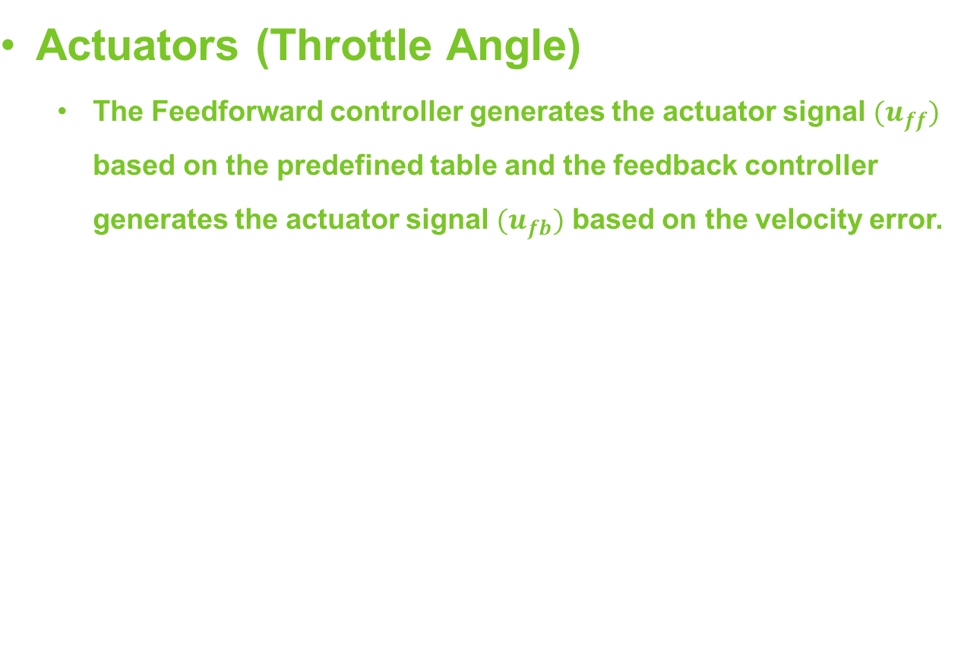






Controller Actuators
Feedforward block gets only the reference signal as input and its primary objective is to accurately set the inputs of the plant.
Feedforward Controller
Reference
Velocity
Vehicle
Velocity
Feedback Controller (PID Controller)

Slide 15




Feedforward Table
Based on kinematic relationship b/w the vehicle’s speed and the wheel angular speed, we can calculate the wheel angular speed, engine angular speed or engine RPM, engine torque, and throttle angle.
Reference
Velocity
Wheel Angular Speed
Engine Angular Speed
Engine Torque
Throttle Angle

Slide 16
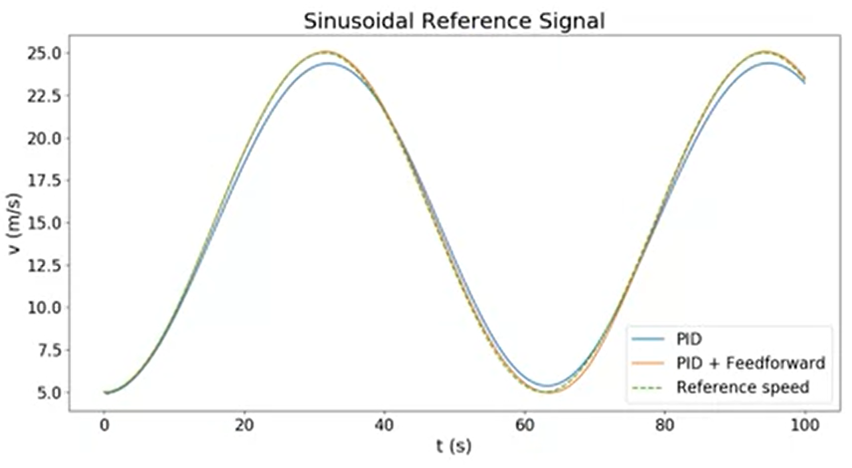
Comparison b/w PID & PID+FF

Slide 17
Summary
In today's lecture we covered the following topics:
Introduction to Feedfroward & Feedback Control
Drawbacks of Feedback Control & Solution
Difference b/w Feedforward and Feedback Control
Importance of Feedforward Control
Combined FF and FB Control
Feedforward with Longitudinal Control
Vehicle Control
Comparison of PID & PID+FF Results (Graph)

Slide 18
Thank You

